Slide 1
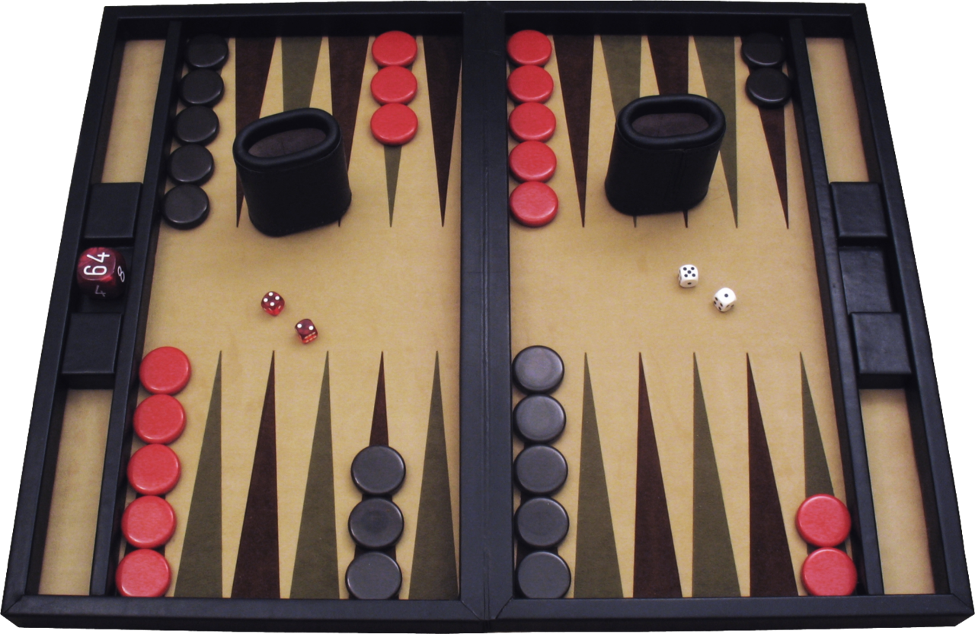
Backgammon
One of the oldest board games, traced back to 5,000 years.

Slide 2
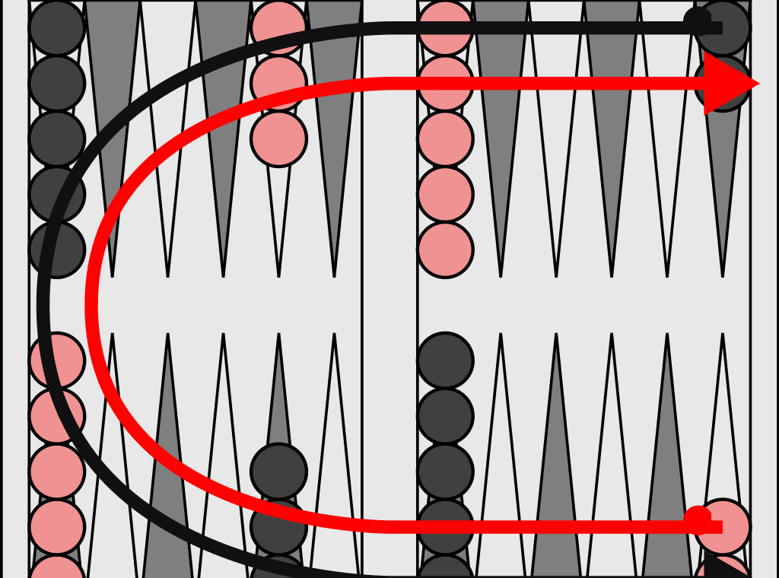
Backgammon
15 pieces
Take turn to dice and move
Towards home

Slide 3
TD-Gammon 1992 by Gerald Tesauro at IBM
Excellent in BackGammon
Notes:
Changed the way the best human players paly the game, its innovated strategy or tactics to play certain opening positions differently than convention among the best human players,, then human began to play the same positions.
Neural networking
Reinforcement learning
Backward propagation

Slide 4
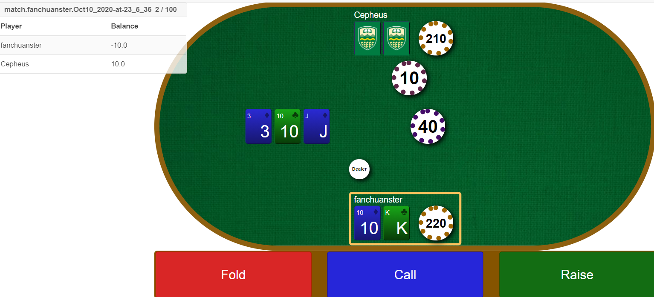
Texas Poker

Slide 5
Texas Poker program plays Very Good
Have a try at University of Alberta’s poker-playing programs (since 1995)
http://poker.cs.ualberta.ca

Slide 6
Pluribus 2019 - beats leading professionals
Darren Elias, who holds the record for most World Poker Tour titles
Chris "Jesus" Ferguson, winner of six World Series of Poker events
Notes:
Michael "Gags" Gagliano, who has earned nearly $2 million in career earnings, also competed against Pluribus.
"It was incredibly fascinating getting to play against the poker bot and seeing some of the strategies it chose. There were several plays that humans simply are not making at all, especially relating to its bet sizing
5,000 hands

Slide 7
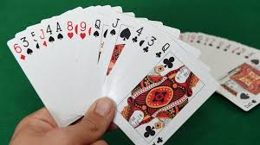
Bridge - GIB 1955- by Matt Ginsberg
https://www.bridgebase.com
“Quirky, occasionally they bid and play well, often makes strange decisions.” Alder 2008
Notes:
At any stage, it knows the cards in its own hand, in the dummy’s hand, and cards played so far.
Assign the remaining cards randomly to the opponents and play based on the assignment.
Goes through the process thousands of times before play a card.

Slide 8
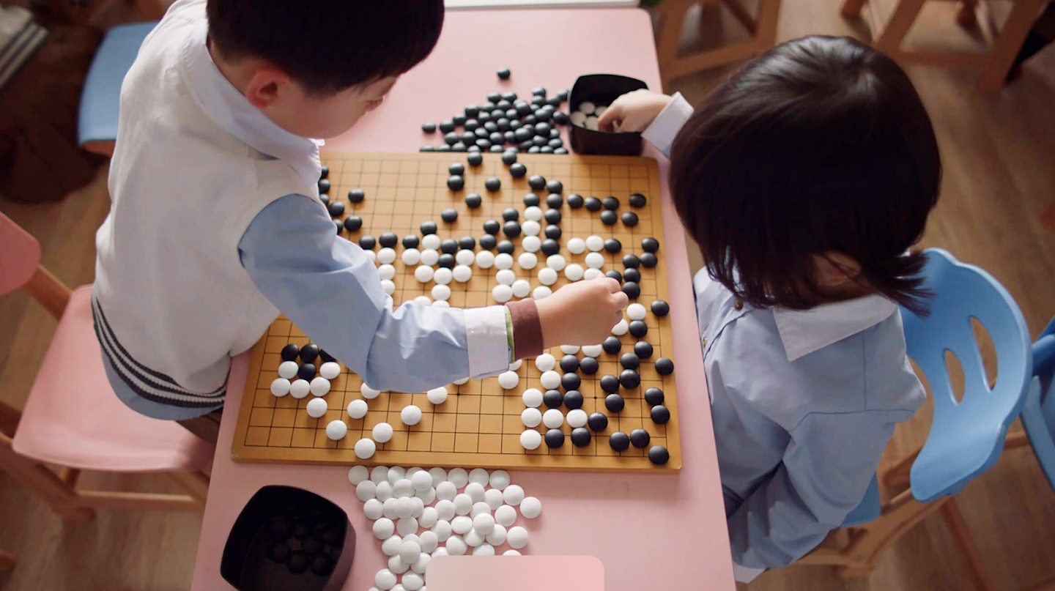
Go – most challenging game for computers
19x19
Notes:
Go is known as the most challenging classical game for artificial intelligence because of its complexity. a googol (1.0 × 10¹⁰⁰ ⁾times more complex than Chess

Slide 9
MoGo Titan 2008
MoGo Titan 2008, beat professional Go player with handicap of nine stones
Notes:
MoGo - developed by INRIA (Institute for Research in Computer Science and Automation) France and
Maastricht University in the Netherlands, beat a professional Go player in a
game in which the computer, the Dutch supercomputer Huygens, was given a
handicap of nine stones
Tree search algorithsm
Patterns
Knowledge

Slide 10
AlphaGo
VS legendary Lee Sedol 4-1 2016
VS world champion Ke jie 3:0 2017.

Slide 11
Algorithm explained a bit in Games
Notes:
We have looked at a variety of games to understand what optimal play means and to understand
how to play well in practice. The most important ideas are as follows:
• A game can be defined by the initial state (how the board is set up), the legal actions
in each state, the result of each action, a terminal test (which says when the game is
over), and a utility function that applies to terminal states.

Slide 12
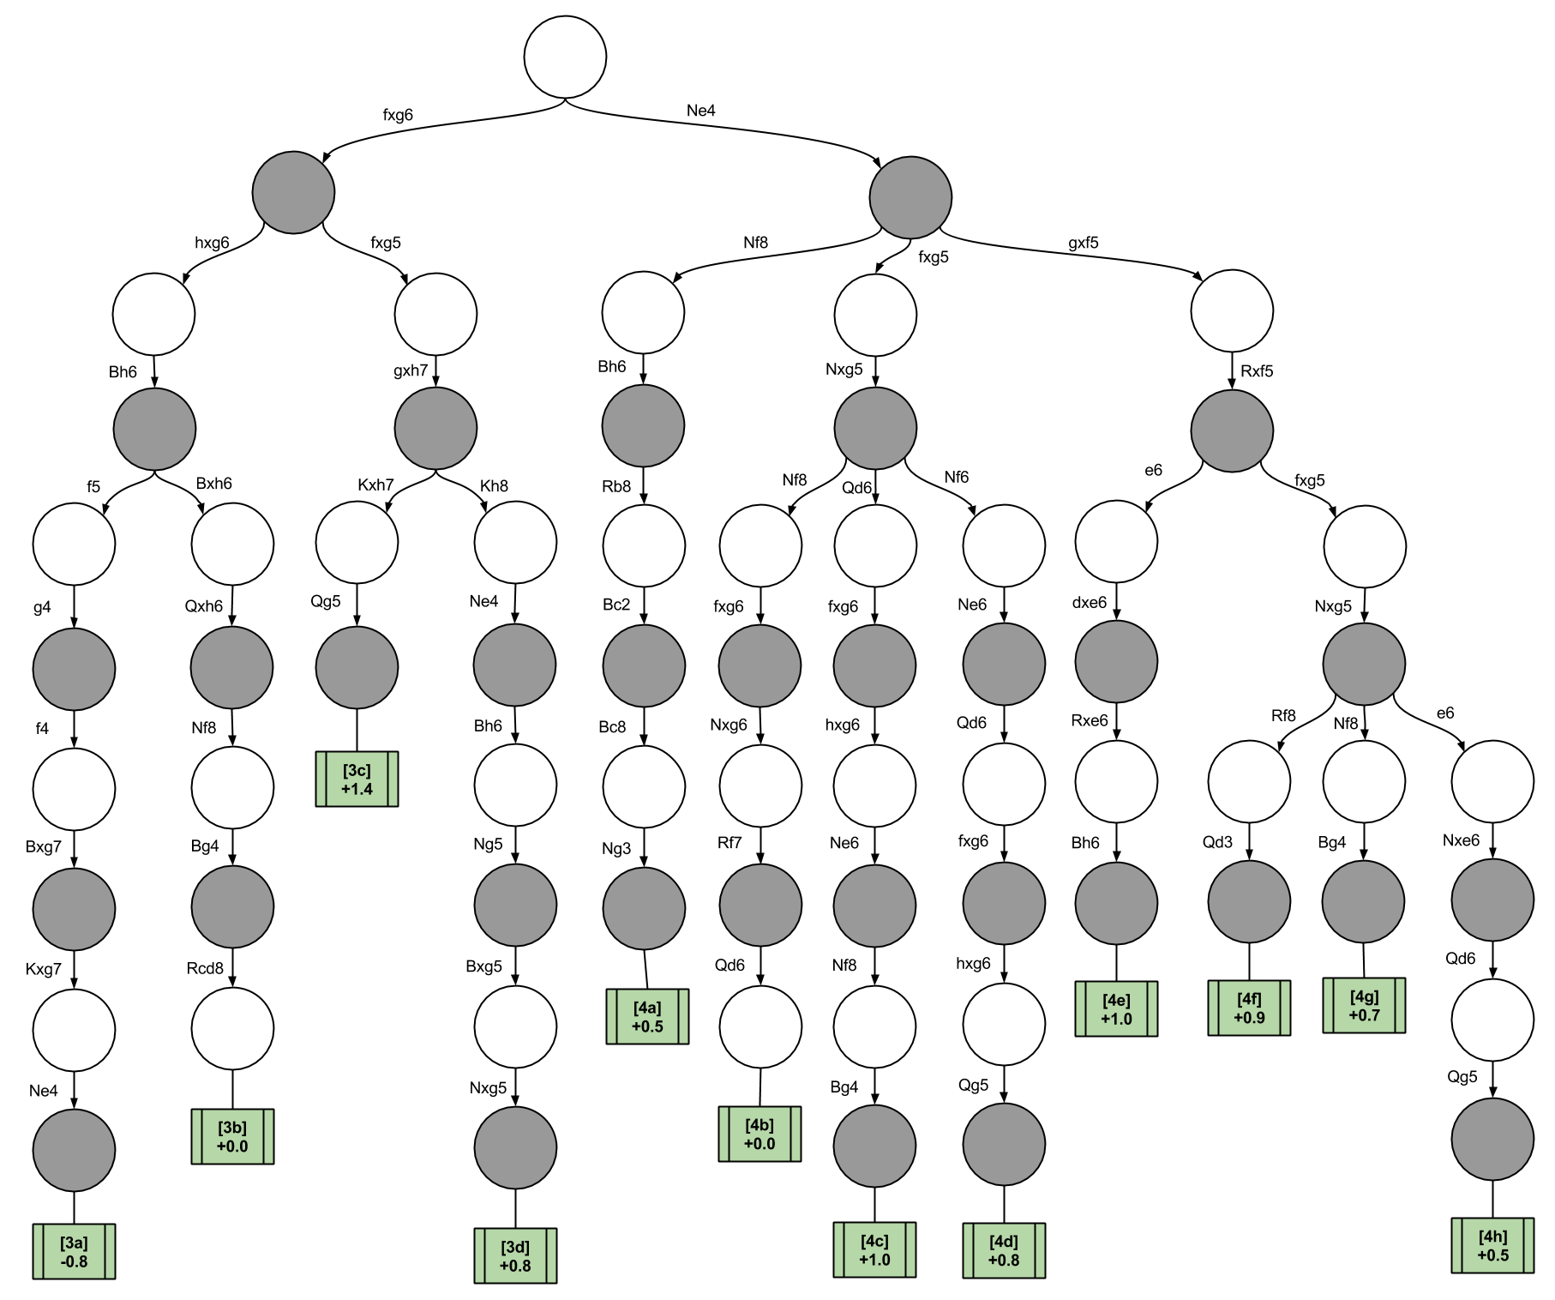
Making decision

Slide 13
A
B1
B2
B3
9
20
30
12
20
10
4
6
7
9
8
MinMax
Notes:
• In two-player zero-sum games with perfect information, the minimax algorithm can
select optimal moves by a depth-first enumeration of the game tree.
Chess, checker,

Slide 14
A
B1
B2
B3
10
4
8
12
20
10
4
6
7
9
8
..
..
..
..
..
..
..
..
..
..
..
..
..
..
MinMax - II
Notes:
• In two-player zero-sum games with perfect information, the minimax algorithm can
select optimal moves by a depth-first enumeration of the game tree.
Chess, checker,

Slide 15
A
B1
B2
B3
10
<=4
<=7
<=12
12
20
10
4
X
X
12
7
X
..
..
..
..
..
..
..
..
..
..
..
..
alpha–beta pruning
Notes:
The alpha–beta search algorithm computes the same optimal move as minimax, but
achieves much greater efficiency by eliminating subtrees that are provably irrelevant.
Best move first
b(3m/4) to b(m/2) : b(m)
Alpha-bata : minmax
Transposition table – avoid recompute same positions by keeping historical result.

Slide 16
A
B1
B2
B3
CutOff test
Heuristic utility evaluation
..
alpha–beta - CutOff
Notes:
Complete computing in limited time and resource
Usually, it is not feasible to consider the whole game tree (even with alpha–beta), so we
need to cut the search off at some point and apply a heuristic evaluation function that
estimates the utility of a state.
Apply heuristic utility evaluation, instead of searching all the way to terminal state:
First, the evaluation function should order the terminal states in the same way as the
true utility function: states that are wins must evaluate better than draws, which in turn must
be better than losses. Otherwise, an agent using the evaluation function might err even if it
can see ahead all the way to the end of the game.
Second, the computation must not take
too long! (The whole point is to search faster.)
Third, for nonterminal states, the evaluation
function should be strongly correlated with the actual chances of winning.

Slide 17
A
B1
B2
B3
Lookup
transposition table
..
Lookup transposition table instead of search/computing
Notes:
transposition table
Many game programs precompute tables of best moves in the opening and endgame so that they can look up a move rather than search
Previously computed position
Must play position, e.g. response to checkmate

Slide 18
A
B1
B2
B3
6
Chance 1
Chance 2
Chance 3
5
4
9
Game of chance – e.g. Backgammon with dice
Notes:
• Games of chance can be handled by an extension to the minimax algorithm that evaluates
a chance node by taking the average utility of all its children, weighted by the
probability of each child.

Slide 19
A
B1
B2
B3
6
Assignment 1
Assignment 2
Assignment 3
5
4
9
Game of imperfect information – e.g. Bridge with unknown assignment
Notes:
Optimal play in games of imperfect information, such as Kriegspiel and bridge, requires
reasoning about the current and future belief states of each player. A simple
approximation can be obtained by averaging the value of an action over each possible
configuration of missing information.

Slide 20

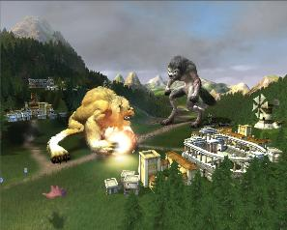
Computer Game - AI
Notes:
developed by Lionhead Studios
uses a combination of neural nets and decision trees.
human players interacts with and competes with artificial agents in the game (nonplayer characters)
NPC can learn strategies, master new abilities and skills, [and] lead armies into battle.
http://AIGameDev.com

Slide 21
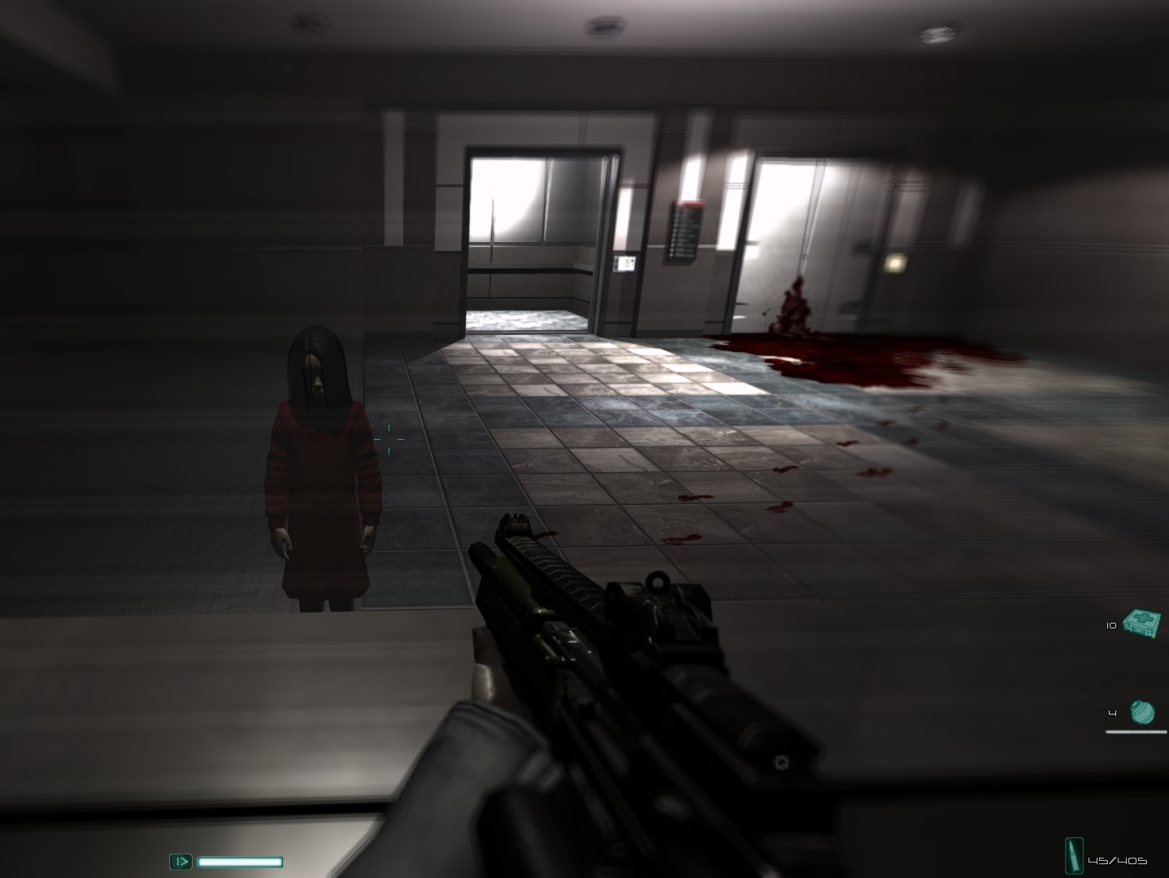
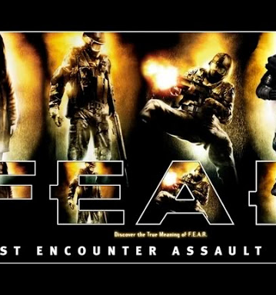
Notes:
The game F.E.A.R. (First Encounter Assault Recon) by Je Orkin and
Monolith Productions uses A to plan sequences of NPC actions in addition to
its usual role in path nding
http://AIGameDev.com

Slide 22
Not frivolous
Convenient Virtual Environment for research new ideas:
Cheap
Reliable
Flexible
“because research in robotics requires solving many difficult problems related to low-level sensing and acting in the real world that are far removed from the cognitive aspects of Intelligence” -- John Laird professor of University of Michigan
Notes:
Some AI researchers have advocated using computer games as a
convenient arena for developing new ideas for intelligent agents. For example,
University of Michigan professor John Laird has written, because research in
robotics requires solving many difficult problems related to low-level sensing
and acting in the real world that are far removed from the cognitive aspects of
intelligence, . . . computer games provide us with a source of cheap, reliable,
and flexible technology for developing our own virtual environments for
research."

